Slide 1
Inventory Management System
Nathaniel Inman Michael Stowe Terry Kleoppel Lucas Gillespie

Slide 2
Purpose
To create a software to contain all the inventory of the client.
To help personnel by including informative descriptions for each item
To keep track of other information related to stock, such as royalties and vendors

Slide 3
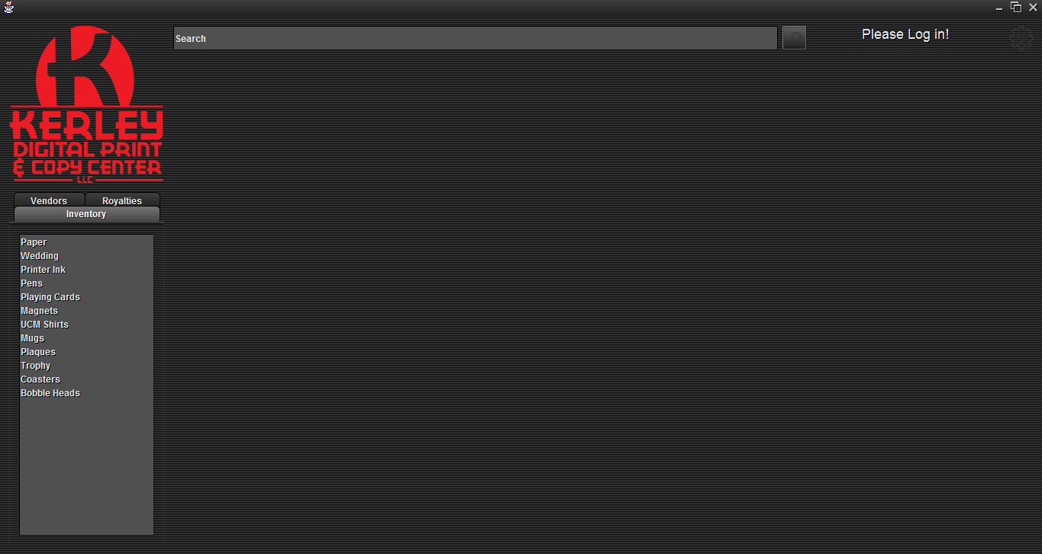
GUI
Notes:
“Gear menu contains Log in, View Users, Add Inventory, Vendor, Royalty, and User Buttons”

Slide 4
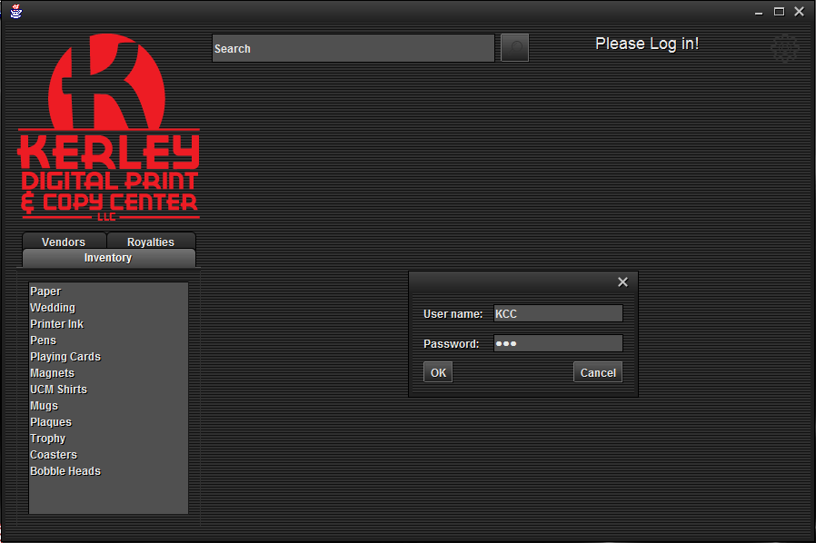
Logging In

Slide 5
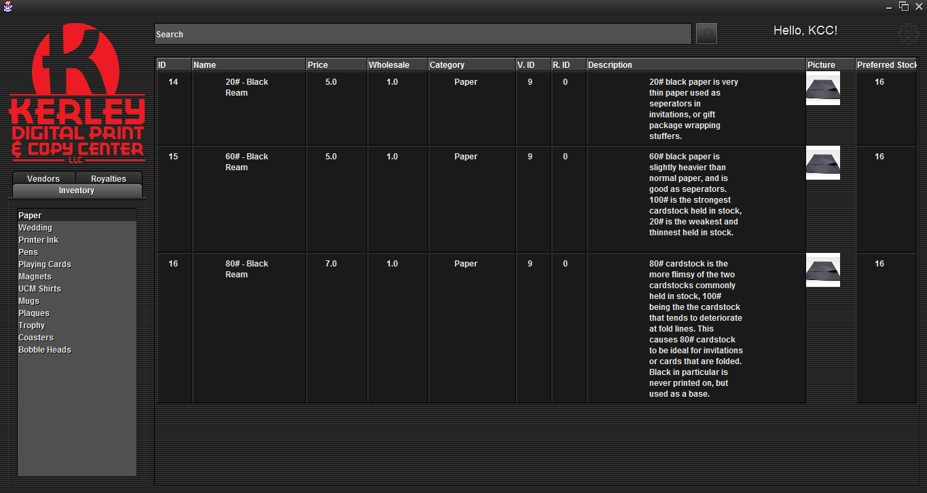
Categories

Slide 6
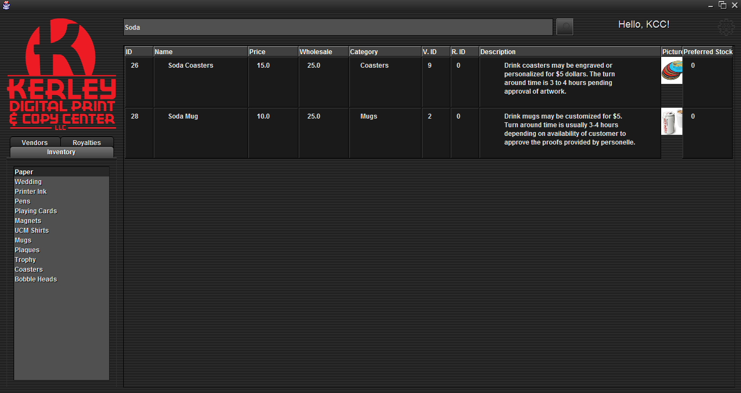
Search

Slide 7
Basic Functionality
User sends input to GUI
GUI sends input to database
Database sends output to GUI
GUI sends output to user
Notes:
“In the simplest terms, this is what our software does. We’ll go into more detail later.”

Slide 8
javax.swing
Standard library of lightweight display components
Easily define layouts and add components
Notes:
“You’re all probably familiar with this already.”

Slide 9
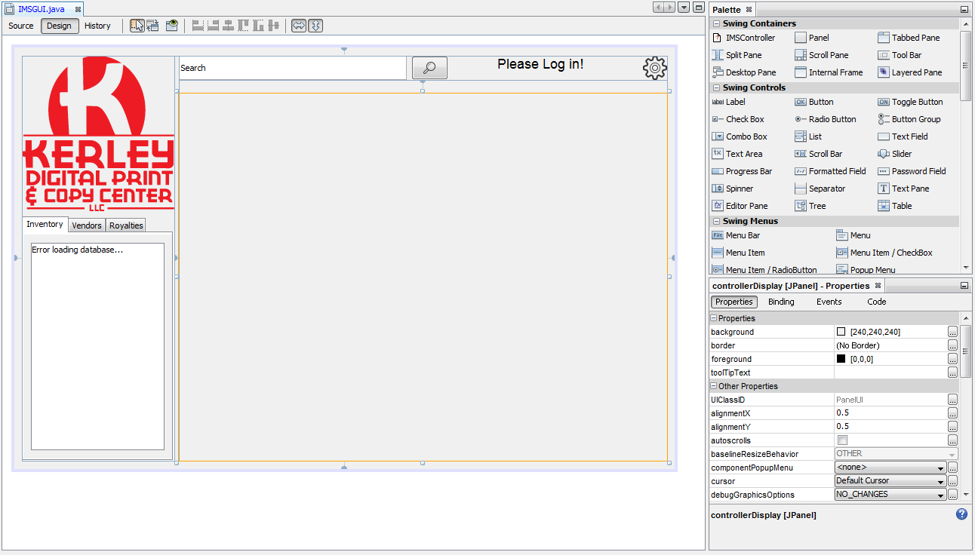
Our Design
Notes:
“This is the NetBeans GUI editor. We were able to design this in a WYSIWYG environment. The highlighted pane is where our main controller class will go, which uses handwritten code.”

Slide 10
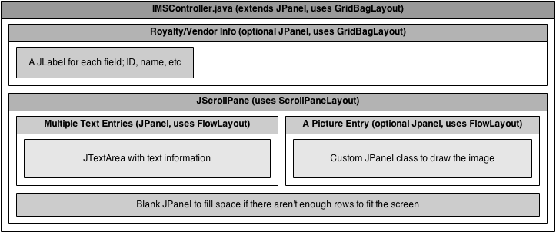
Our Design
Notes:
I’m just going to briefly explain everything here.

Slide 11
Implementation Challenges
We had to write our own text wrapping function
We had to make a custom JPanel class for images
The subtle differences between classes such as JLabel, JTextPane, and JTextArea, as well as between different layout options, caused confusion
Notes:
I’m just going to briefly go over some of the things that gave us (me) the most trouble.

Slide 12
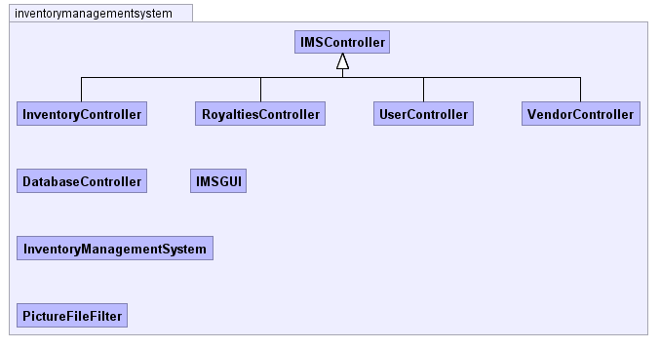
Structure

Slide 13
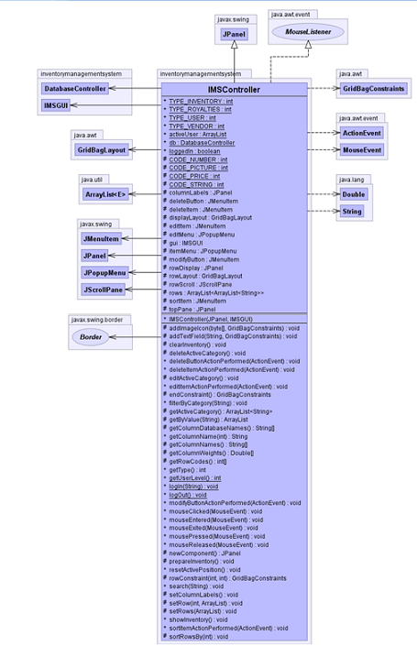
IMSController
What does it do?
IMSController is the base class that other controllers will extend to.
Gives permissions to users. Depending on the level the user has he/she can modify data.
Sorting Algorithm and Search functions are in this class.

Slide 14
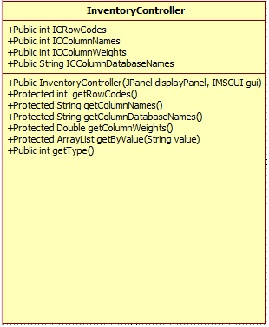
InventoryController
What does it do?
It controls the main aspects of an inventory.
InventoryController gets the ID, Name, Price, Wholesale, Category, Vendor ID, Royalty ID, Description, Picture, and Preferred Stock,

Slide 15
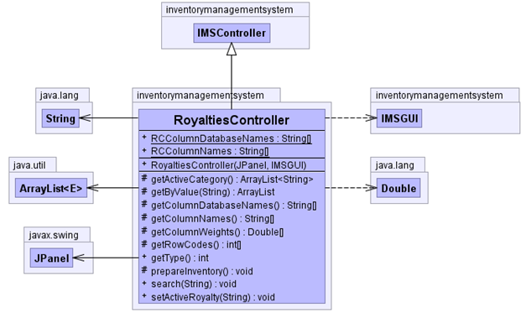
RoyaltiesController
What does it do?
RoyaltiesController manages the royalties .
RoyaltiesController has a gets Royalties: ID, Name, Phone Number , Ext, Addresses , Website, E-mail, PPOC, Royalties.

Slide 16
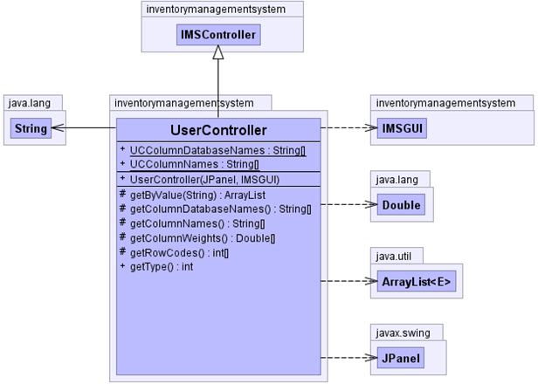
UserController
What does it do?
User Controller is used predominately for creating new users and changing login credentials.
UserController methods are gets Users: ID, User Name, Password, Level.

Slide 17
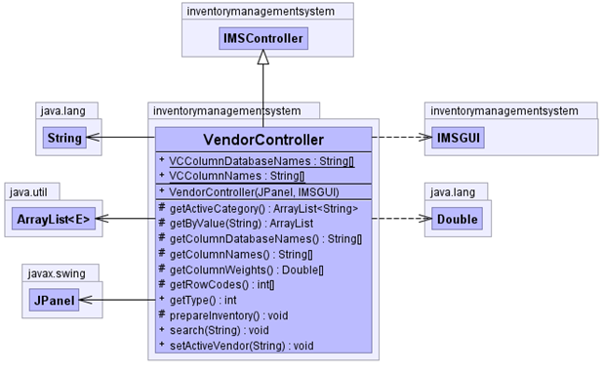
VendorController
What does it do?
VendorController manages Vendors.
VendorController shows items that vendors sells.
VendorController is similar to RoyaltiesController. Except it doesn’t have get Royalties.

Slide 18
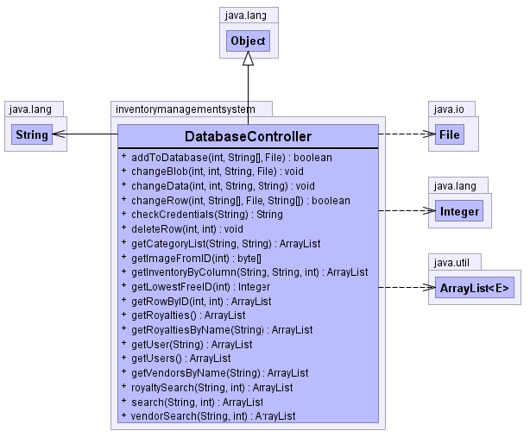
DatabaseController
What does it do?
DatabaseController purpose is to establish connections with the database. Makes the data viewable for the Controllers.
DatabaseController has a way to retrieve data stored in Database such as: Inventory, Royalties, Users, Vendors.

Slide 19
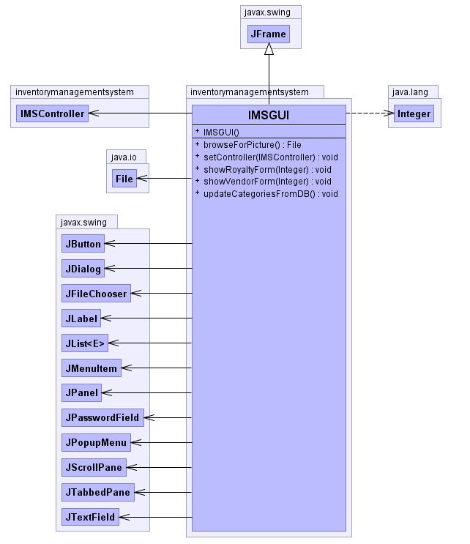
IMSGUI
What does it do?
It provides an graphical user interface.
Contains all the graphical design components
Small with a handful of items
.

Slide 20
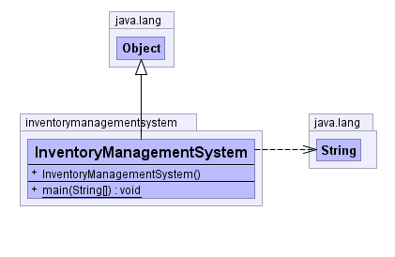
InventoryManagementSystem
What does it do?
It is the main hub from where everything is connected.
Provides the main scope.
Dictates class distribution.
.

Slide 21
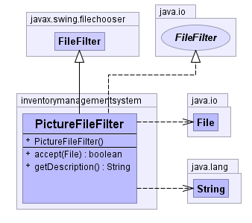
PictureFileFilter
What does it do?
Makes it easier for the user to which file they want to upload for the picture of the inventory item that they are creating.
It browses users systems.

Slide 22
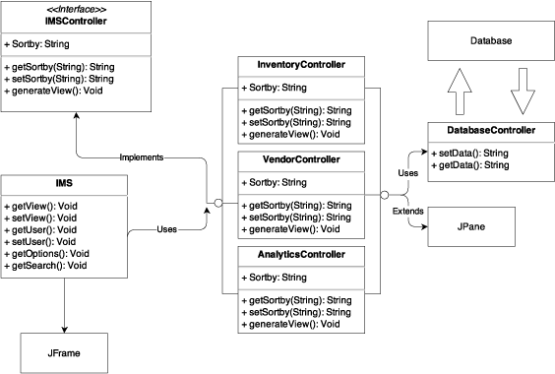
Model View Controller

Slide 23
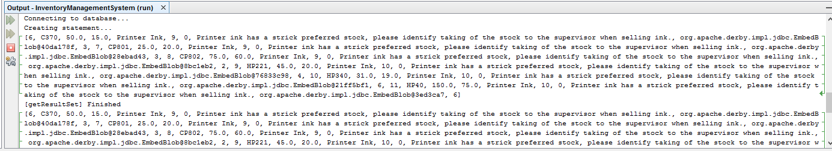
Debugging

Slide 24
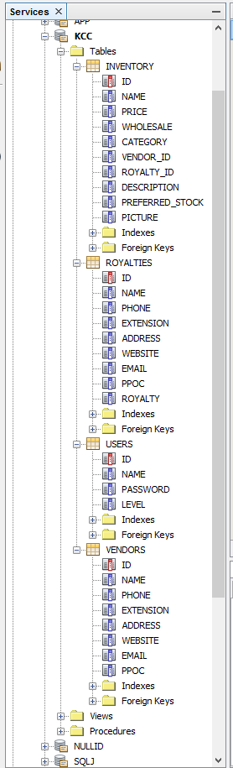
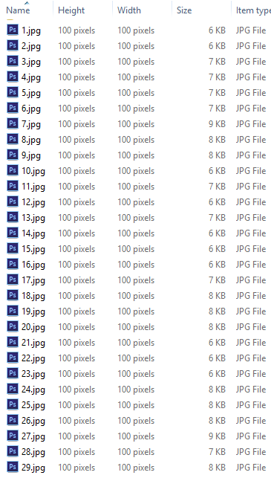
Data

Slide 25
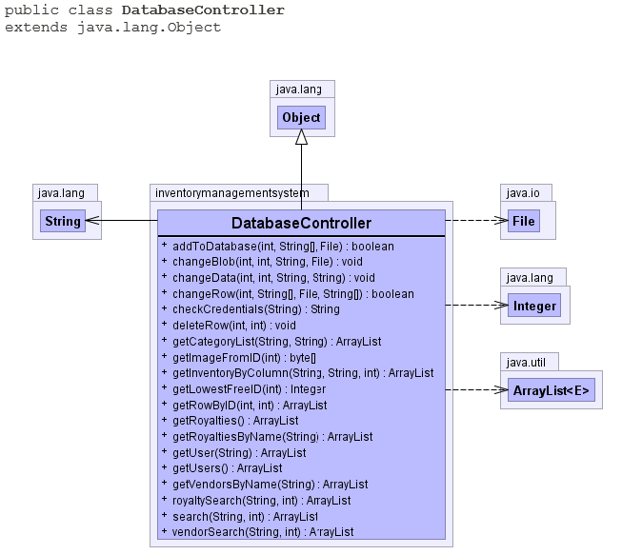
Database Controller

Slide 26
Infeasible Components
Sales Tracking
Analytics
MySQL Database
Live Update of Website Inventory

Slide 27
References
https://www.draw.io – UML Diagram system used for DD
yWorks Doclet – Auto-documentation system designed for Java
www.gradle.org – Automated Unit Testing Environment
Pegdown Doclet project - Replaces comments with Markdown
http://creativecommons.org/licenses/by/3.0/ - Creative Commons License for Linecons Free – Vector Icons Pack by Designmodo

